Slide 1
University of Babylon
Faculty of Engineering
Removal of Fluoride from semiconductor wastewater using aluminium-based electrocoagulation cell
Prof. Dr Mohammed M.Kadhum
Email: eng.mohammed.mansour@uobabylon.edu.iq
Assist. Prof. Dr Khalid Safaa
Email: eng.khalid.saffa@uobabylon.edu.iq
Assist. Lect. Haneen A .Haleem
Email: haneen.ali@uobabylon.edu.iq

Slide 2
University of Babylon
Faculty of Engineering
Abstract
The current study employed the electrocoagulation (EC) method to remove fluoride from simulated semiconductor wastewater. The EC cell was supplied with three pairs of aluminium electrodes with an effective area of 120 cm², and the removal of fluoride was optimised for the effects of the initial pH (3, 6 and 9), the distance between electrodes (3, 6 and 9 mm) and current density (2, 4 and 6 mA/cm²). The results obtained demonstrated the good efficiency of the aluminium-based EC cell; it removed as high as 97% of the fluoride within the first 20 minutes of treatment at a pH of 6, distance between electrodes of 3 mm and current density of 6 mA/cm². Therefore, it could be concluded that the aluminium-based EC cell is a potential alternative to the conventional treatment methods.

Slide 3
University of Babylon
Faculty of Engineering
Introduction
Semiconductor wastewater refers to the contaminated water generated during the manufacturing processes of semiconductors, which are fundamental components of electronic devices like computers, smartphones, and integrated circuits. Semiconductor manufacturing involves various complex processes such as photolithography, chemical etching, ion implantation, and chemical vapor deposition. These processes often require the use of a wide range of chemicals, including acids, solvents, and various other materials, which contribute to the contamination of wastewater with a wide range of pollutants, such as arsenic, fluoride, phosphate, sulphate, lead, cadmium, and various organic chemicals.
Thus, improper disposal or treatment of semiconductor wastewater can lead to pollution of water bodies, soil, and even the atmosphere. The chemicals and heavy metals in this wastewater can have adverse effects on ecosystems and human health.

Slide 4
University of Babylon
Faculty of Engineering
Introduction
Nowadays, various treatment technologies, such as chemical precipitation, ion exchange, reverse osmosis, and activated carbon filtration, are used to treat their wastewater. However, the majority of these technologies are either expensive, such as the reverse osmosis, or involves chemical additions , such as chemical precipitation.
Thus, there is a need for reliable, affordable and efficient water treatment method to treat this type of wastewaters.
In this context, this study aims at applying the EC method to remove fluoride from semiconductor wastewater. The EC method was used due to its ease of operating, affordability and safety.

Slide 5
University of Babylon
Faculty of Engineering
Materials and Methods
Simulated wastewater: (The simulation process was carried out according to the procedures stated by Aoudj et al., 2017.)
The preparation process started by diluting of 1 N of Hydrofluoric acid stock solution in deionised water and then reacted with lime. Finally, measured amounts of ammonia and Sodium Dodecyl sulphate were also added to the simulated solution. The latter was then subjected to a rapid mixing at 400 rpm for 2 minuets, the pH was adjusted to the desired value and moderately stirred (200 rpm) for 30 min.
The solution was, then, immediate transferred to the EC cell.
Fluoride concentration was measured using Hach-Lange fluoride cuvettes test (LCK323) and a Hach-Lange spectrophotometer (Model: DR 2800).
Aoudj, S., Khelifa, A. and Drouiche, N., 2017. Removal of fluoride, SDS, ammonia and turbidity from semiconductor wastewater by combined electrocoagulation–electroflotation. Chemosphere, 180, pp.379-387.

Slide 6
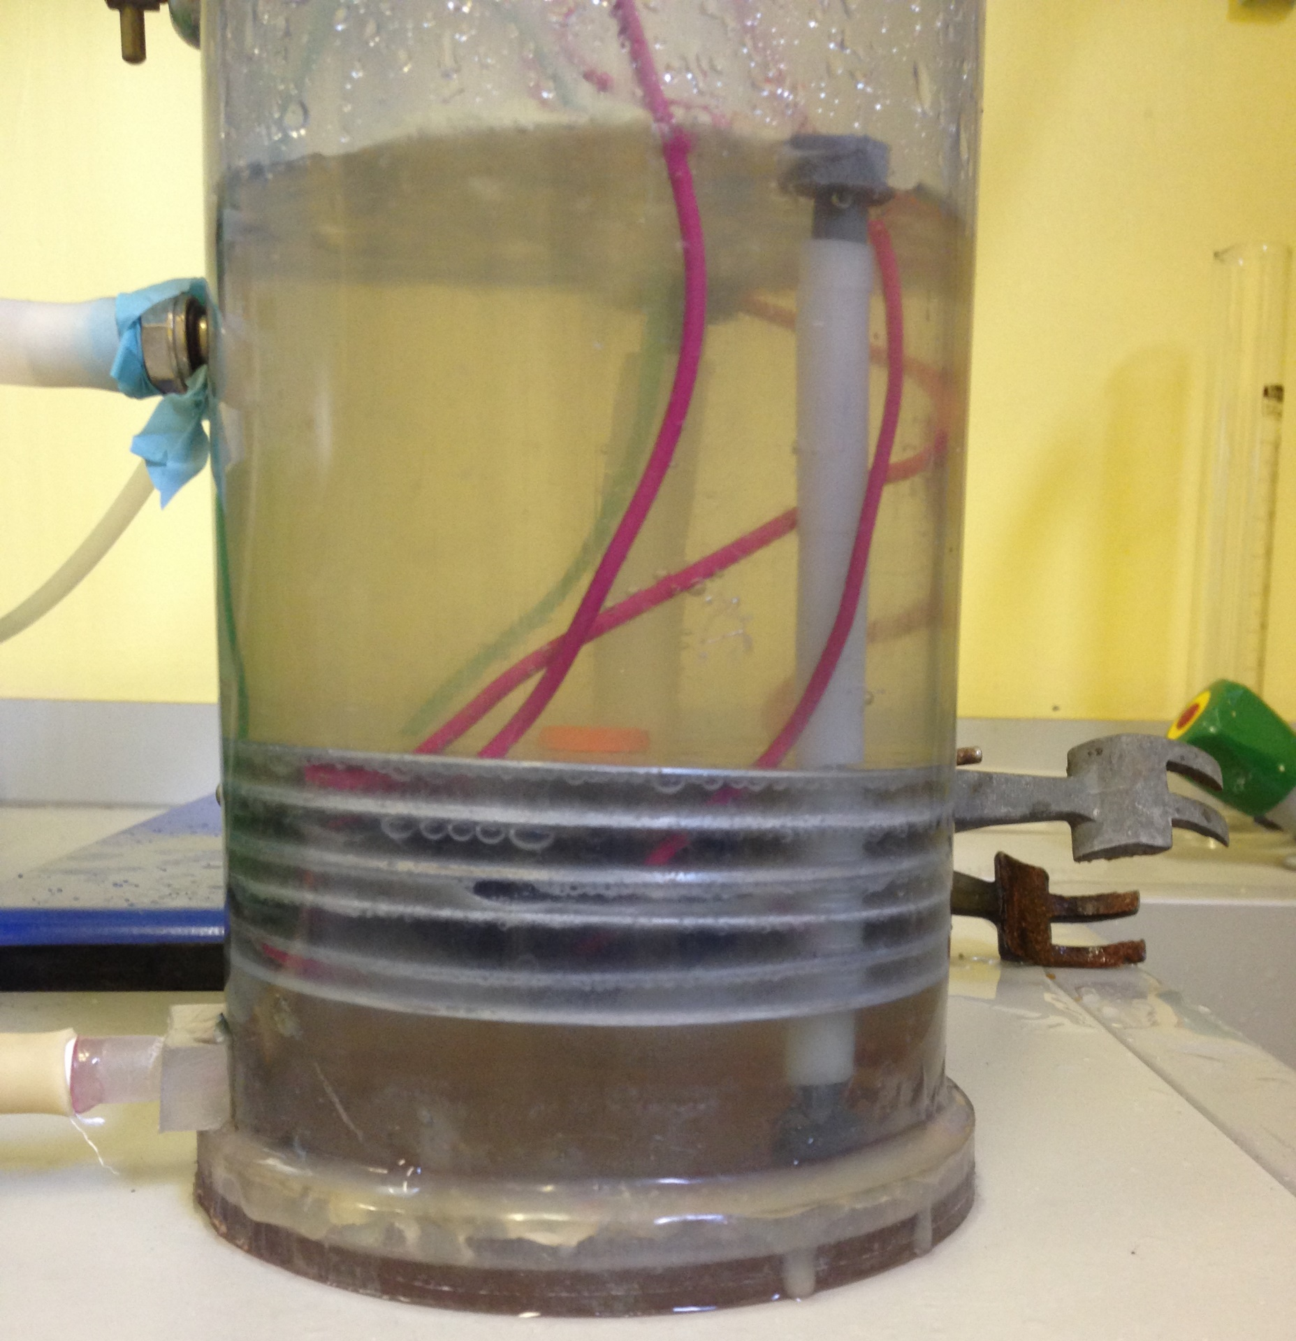
University of Babylon
Faculty of Engineering
Materials and Methods
EC Cell
The EC cell is shown in Fig. 1.
The required current density was supplied using a DC rectifier (HQ Power;
Model: PS 3010).
The experimental conditions were:
Initial pH (3, 6 and 9)
Distance between electrodes (3, 6 and 9 mm)
Current density (2, 4 and 6 mA/cm²).
Solution
Aluminium electrodes
Fig. 1: The EC cell.

Slide 7
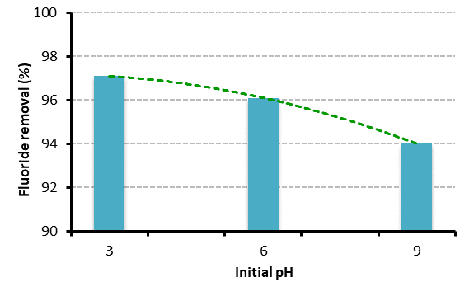
University of Babylon
Faculty of Engineering
Results
Effects of the initial pH
The best pH was 3,as shown in Fig. 2. However, pH 6 was used because the difference in the removal efficiency at pH 3 and 6 was not significant. Also, to avoid high additions of acids
Fig. 2: Effects of the initial pH on fluoride removal

Slide 8
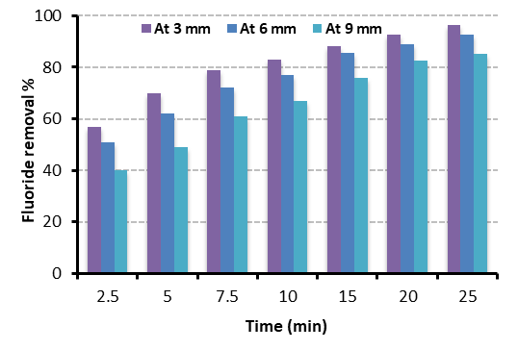
University of Babylon
Faculty of Engineering
Results
Effects of the distance between electrodes
The best distance was 3 mm, as shown in Fig. 3. Therefore, it was used in the rest of experiments.
Fig. 3: Effects of distance between electrodes on fluoride removal

Slide 9
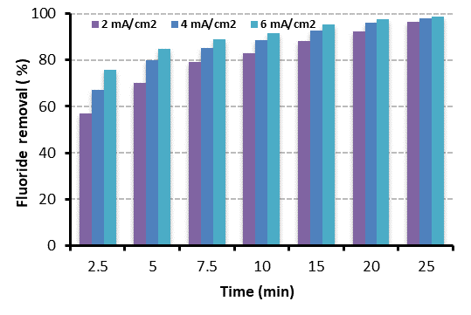
University of Babylon
Faculty of Engineering
Results
Effects of the current density
The best current density was 6 mA/cm², as shown in Fig. 4. Therefore, it was used in the rest of experiments.
It can be seen that the removal efficiency was almost the same at times 20 and 25. Thus, the best treatment was considered as 20 minutes
Fig. 4: Effects of the current density on fluoride removal

Slide 10
University of Babylon
Faculty of Engineering
Conclusion
Experimentally, the ability of the new EC cell to remove fluoride from wastewater was investigated taking into consideration the effects of different operational parameters, including the initial pH, current density and inter-electrode distance. The results revealed that the fluoride removal could be enhanced by increasing either the current density or minimising the pH and/or the distance between electrodes.
It was found that about 20 min was quite enough to meet the WHO requirements when the initial fluoride concentration was 10 mg/L. Therefore, the EC cell could be a cost-effective alternative to the traditional lab scale EC reactors.
It is recommended to invistigate the effects of other parameters, such the solution temperature and mixing speed.

