Slide 1
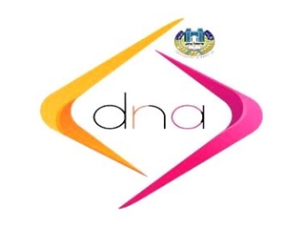
Computer recycling
Prof. Dr. Lubna Abdulazeem
DNA Research CENTER
UNIVERSITY OF BABYLON

Slide 2
What is electronic waste?
All expired computers and all their accessories, mobile devices, electrical appliances such as microwaves and refrigerators, televisions, receivers and transmitters, cameras, photocopiers and printing equipment, fluorescent lamps,...etc.

Slide 3
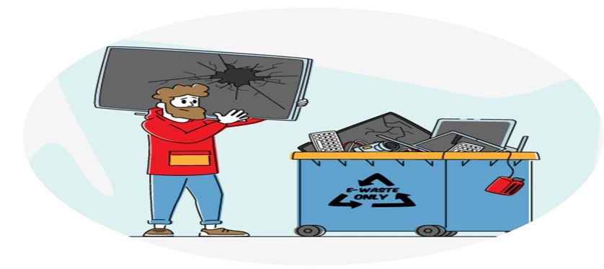
Electronic waste
Electronic waste contains toxic substances that harm humans and the environment, and when these devices are disposed of randomly, their toxic elements leak into natural resources, such as water, air, and soil, and reach through the food chain or by inhalation to humans. It is part of the Ministry’s efforts aimed at improving waste management, especially electrical waste, and electronic. The aim of this study, protecting the environment and achieving sustainable development.

Slide 4
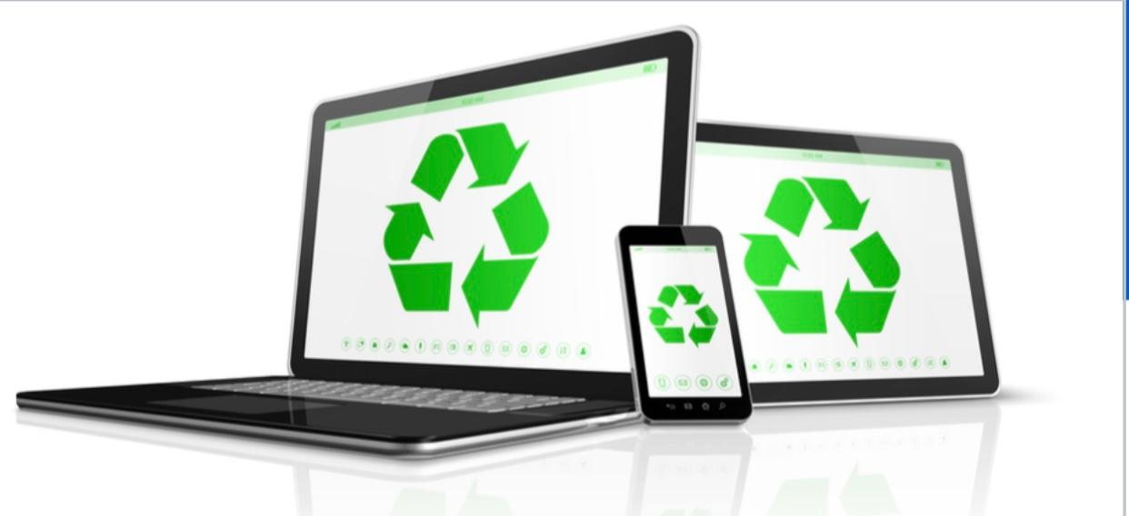
Electronic waste that must be collected through this study:
Computers and all their accessories.
Mobile phones.
Bulbs of all kinds.
Dry batteries of all kinds.

Slide 6
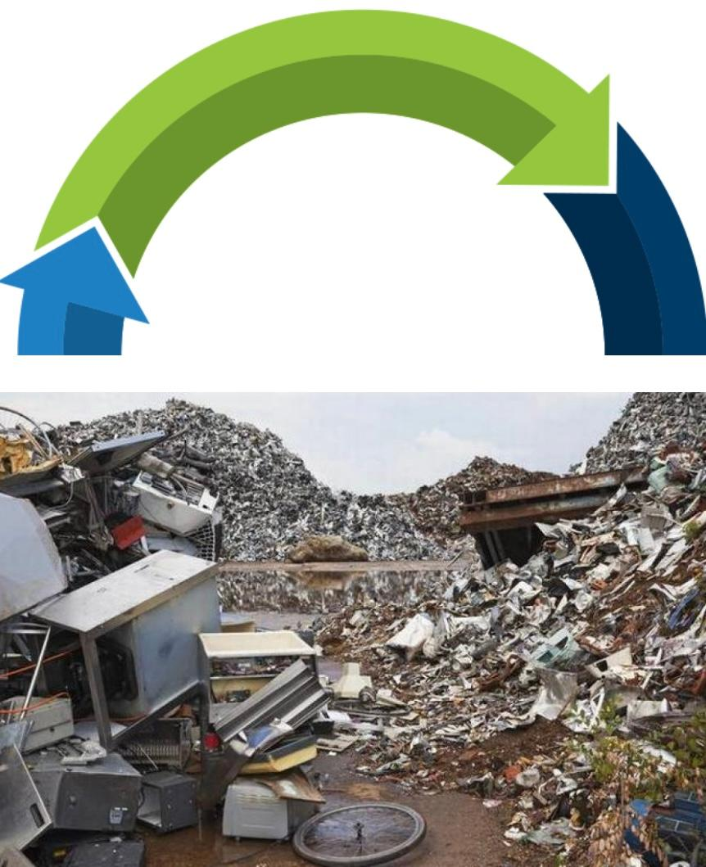
Rotation
It is an act of processing your waste in order to produce new goods. Instead of throwing away unwanted materials, you can simply recycle them to manufacture a new good. In addition, recycling helps reduce the amount of waste that usually collects in a landfill, and thus helps To reduce the amount of toxic chemicals that are buried in the ground.

Slide 7
Recyclable materials
Fluorescent lamps (aluminium, glass, mercury).
Dry batteries (lead and plastic are reused to make new batteries).
Mobile phone and rechargeable batteries (cadmium, nickel and iron can be reused).
Television (glass and lead are reused).
Computer (mercury, steel, plastic and gold are reused).
Computer screens (glass, gold and lead can be reused).

Slide 8
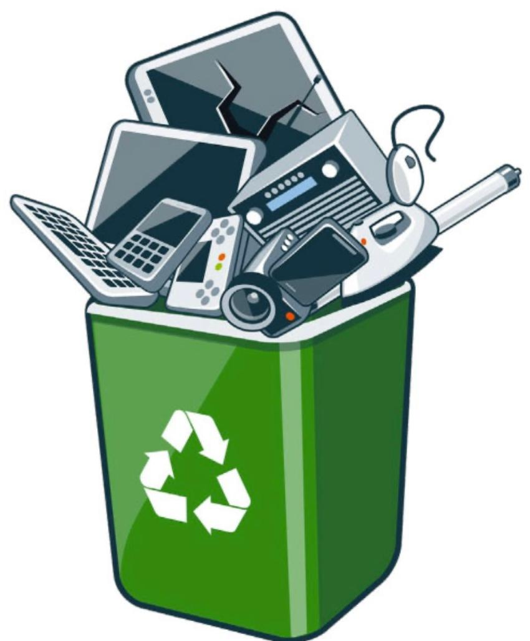
Electrical and electronic waste management policy
1- Activating the prohibition of throwing electrical and electronic waste into solid waste landfills as household waste, dealing with it in a special manner commensurate with its danger, and developing appropriate mechanisms for sorting, collecting, recycling, treating, disposing of it, or exporting it for treatment.

Slide 9
2- Reducing the production of electrical and electronic waste to reduce its impact on the environment through:
A- Use of less toxic materials in production processesUsing recycled materials in production processes and reducing the use of primary raw materials as permitted for different products.
B- Using the best available technologies and best environmental practices.
C- Producing and importing reusable and recyclable products.
D- Follow the internationally used and locally approved treatment methods that have been proven to be appropriate in a way that preserves environmental elements, and benefit from the guidelines issued by the relevant accredited bodies.

Slide 10
E- Encouraging the provision of a comprehensive treatment system for all types of electrical and electronic waste at the local level.
F- Work to approve specific centers for storing and treating electrical and electronic waste in accordance with approved international standards and to be sufficient to deal with the waste generated in the Kingdom.
G- Encouraging the private sector to invest in the field of electrical and electronic waste, including collecting, transporting, recycling and final disposal of waste.

Slide 11
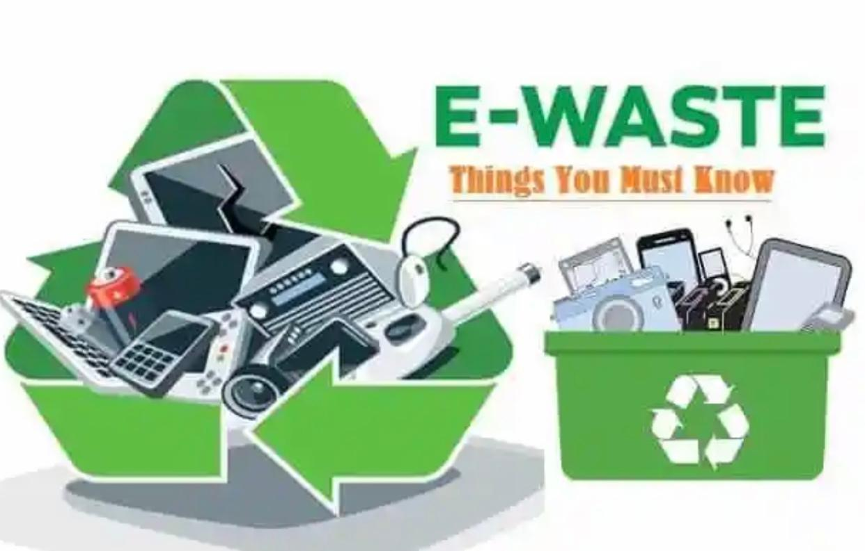
H- Adopting an incentive system for sorting and collecting electrical waste Environmental impacts resulting from mismanagement of electronic waste.

Slide 12
The presence of toxic substances in these wastes and the absence of the necessary safety and prevention conditions while dealing with them pose a threat to health and natural resources, especially soil and water.

Slide 13
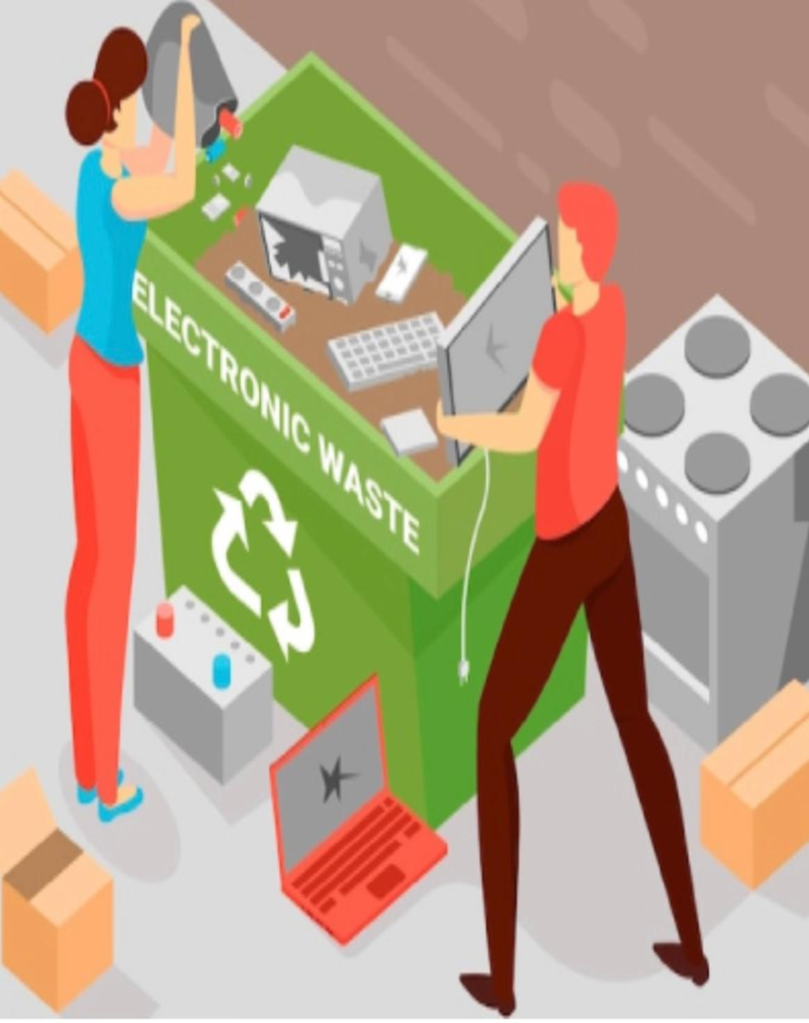
The most important toxic elements and substances found in electronic waste are the following:
Toxic substances effects/dangers
Where do you find them?

Slide 14
Arsenic
Growth problems.
heart disease.
cancer and diabetes.
Microwaves.
electronic circuit boards.
Inverters.
Motors.

Slide 15
Cadmium
Calcium loss.
Pain.
osteoporosis.
lung damage and death.
Cellular or mobile phone batteries.

Slide 16
chrome
Skin irritation.
rash .
A strong material used in the plastic industry.

Slide 17
Copper
Sore throat and lungs.
liver and kidney damage.
Copper wires.
electronic circuit boards.

Slide 18
Lead
Dysfunction in cognitive and verbal activity.
paralysis.
coma and death Computer.
monitor.
TV and batteries.

Slide 19
Nickel
If the dose is high.
it may lead to cancerous diseases.
Rechargeable batteries.

Slide 20
Silver
If the dose is repeated, argyria (blue and gray spots on the skin) can occur.
Cellular or mobile phones

Slide 21
Beryllium
A substance that causes cancerous diseases.
Connectors.
Plastic,

Slide 22
polyvinyl chloride
It damages the immune system and causes cancer.
Screens,
keyboards,
mice,
laptops,
USB keys.

Slide 23
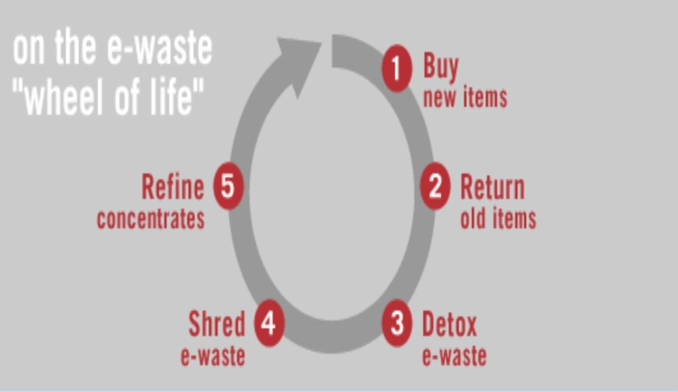
CONCLUSION
This age of information and communication technology, electronic and electrical devices have become almost indispensable. Owing to the fast-developing nature of the technology, many such devices become obsolete within a few years of their production. These factors, along with the growth in demand due to increasing purchasing power of people across the world, lead to the generation of enormous quantities of e-waste. While e-waste recycling is being carried out in many parts of the world to.

